Slide 1
Weight Merge for 3DGS

Slide 2
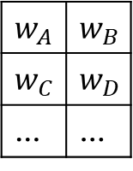
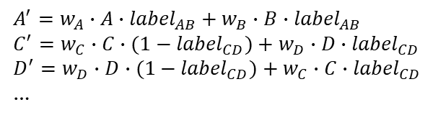
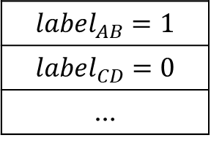
Gaussian Points
A pair of selected gaussians
Selected
For Gaussian[selected]: do merge;
For Gaussian[not selected]: multiply with weights respectively.
Not selected
A
B
A’
Random Selection
C
D
C’
D’
Render
IMG
Selection Mask
Weight Matrix
…
$$w_{A}$$ | $$w_{B}$$
$$w_{C}$$ | $$w_{D}$$
… | …
$$A^{′}=w_{A}∙A∙{label}_{AB}+w_{B}∙B∙{label}_{AB}$$
$$C^{′}=w_{C}∙C∙{(1−label}_{CD})+w_{D}∙D∙{label}_{CD}$$
$$D^{′}=w_{D}∙D∙{(1−label}_{CD})+w_{C}∙C∙{label}_{CD}$$
…
Selection Tensor
Selection Mask
0.9
0.1
…
$${label}_{AB}=1$$
$${label}_{CD}=0$$
…
Gumbel-Softmax

Slide 3
Remarks
To confine the sum of Truths in mask to be a certain value, we may corporate a loss for the selection mask:
sum of Truths → certain value ↔ loss for selection mask → 0
For the convenience of backpropagation, we may multiply the label from selection mask during merging

